Slide 1

Home Page
Notes:
shape
No alt text provided
shape
No alt text provided
shape
No alt text provided
shape
No alt text provided
shape
No alt text provided
textbox
No alt text provided

Slide 2
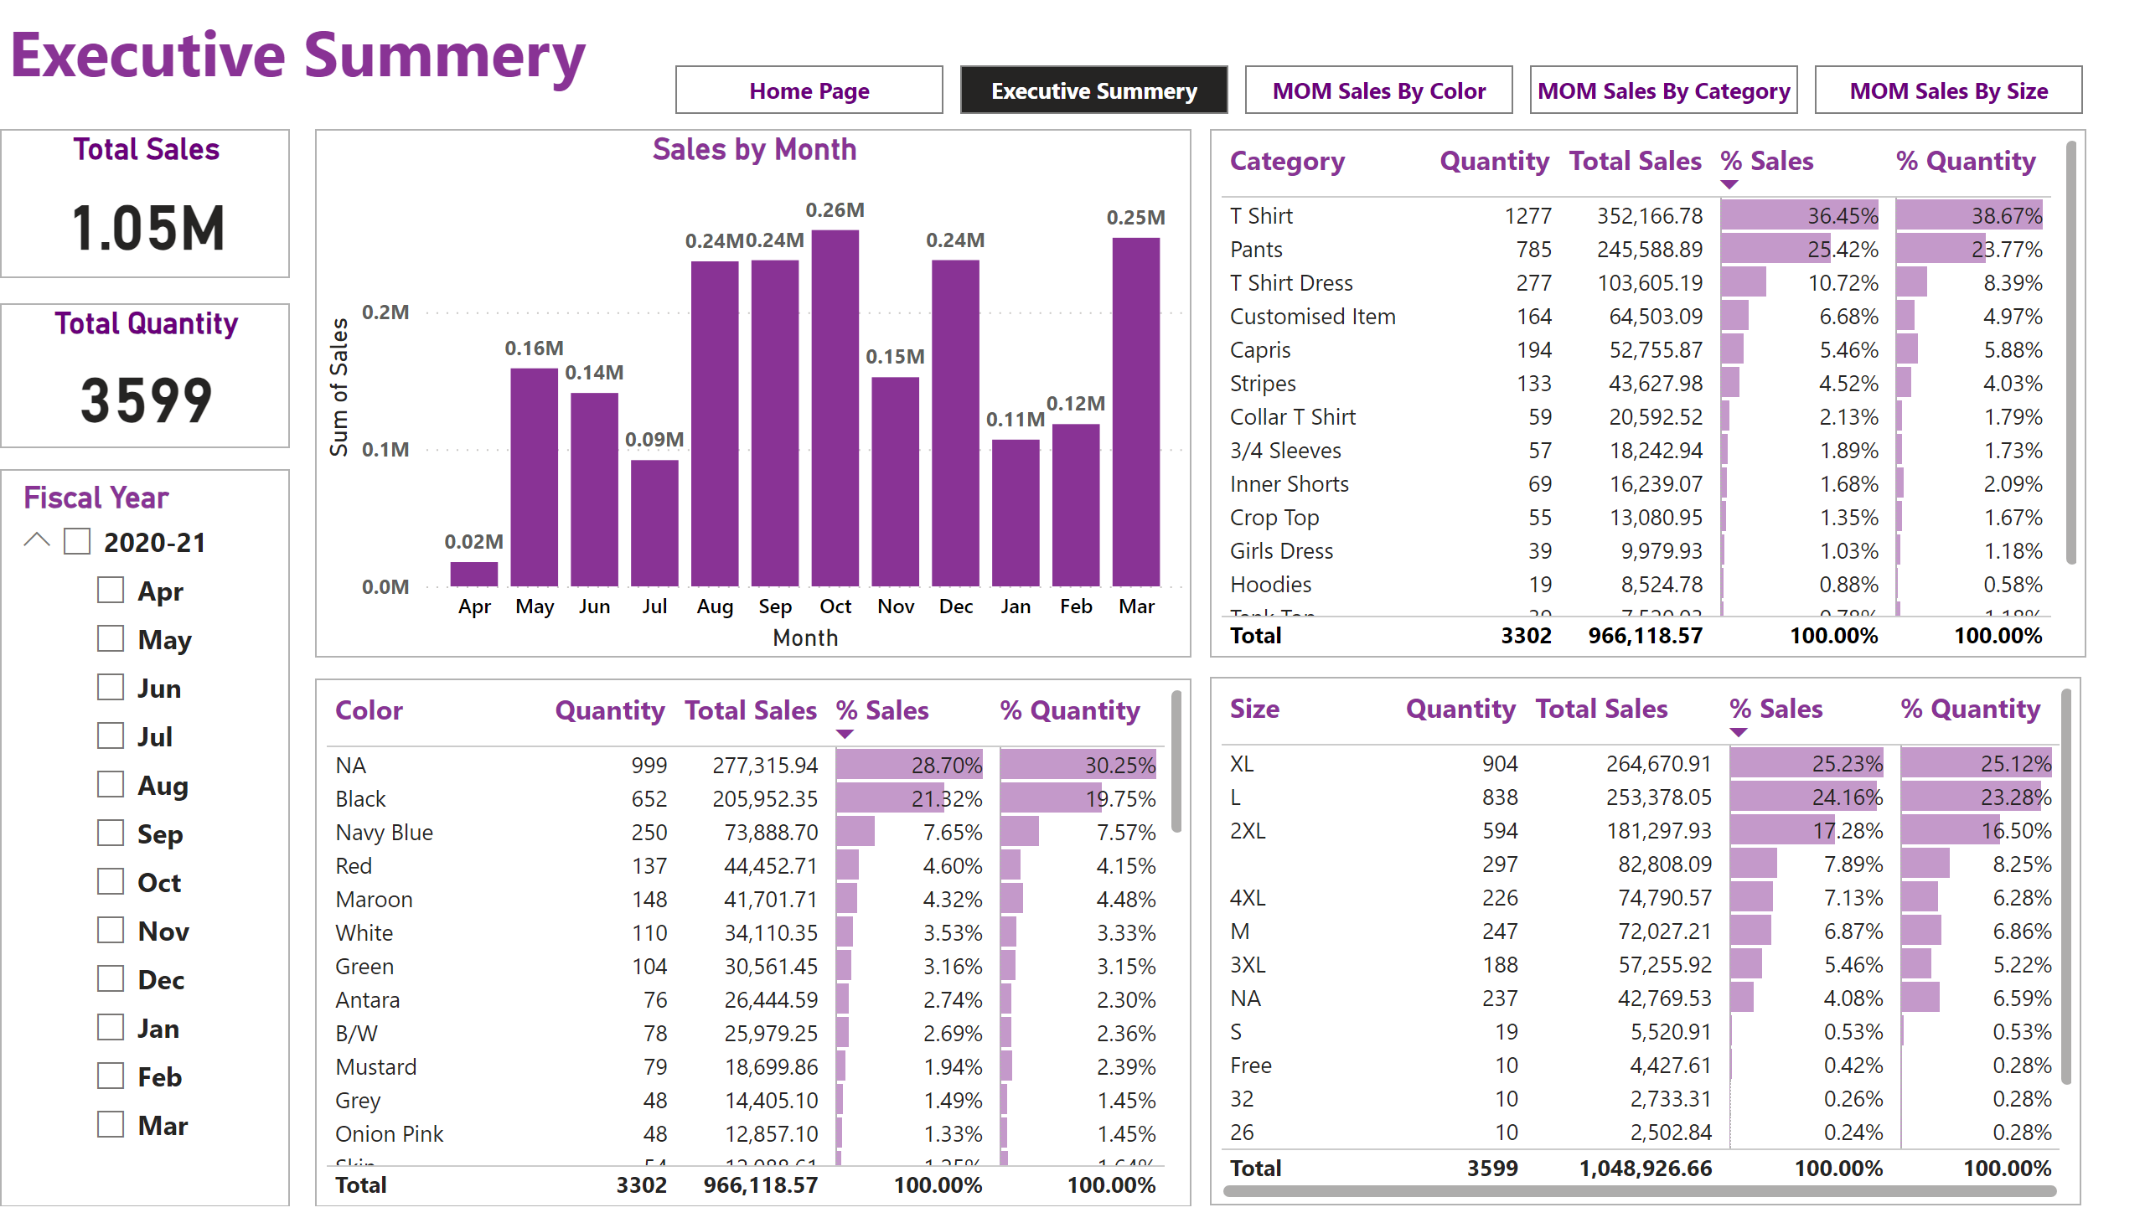
Executive Summery
Notes:
slicer
No alt text provided
tableEx
No alt text provided
tableEx
No alt text provided
tableEx
No alt text provided
textbox
No alt text provided
Total Sales
No alt text provided
Total Quantity
No alt text provided
pageNavigator
No alt text provided
Sales by Month
No alt text provided

Slide 3
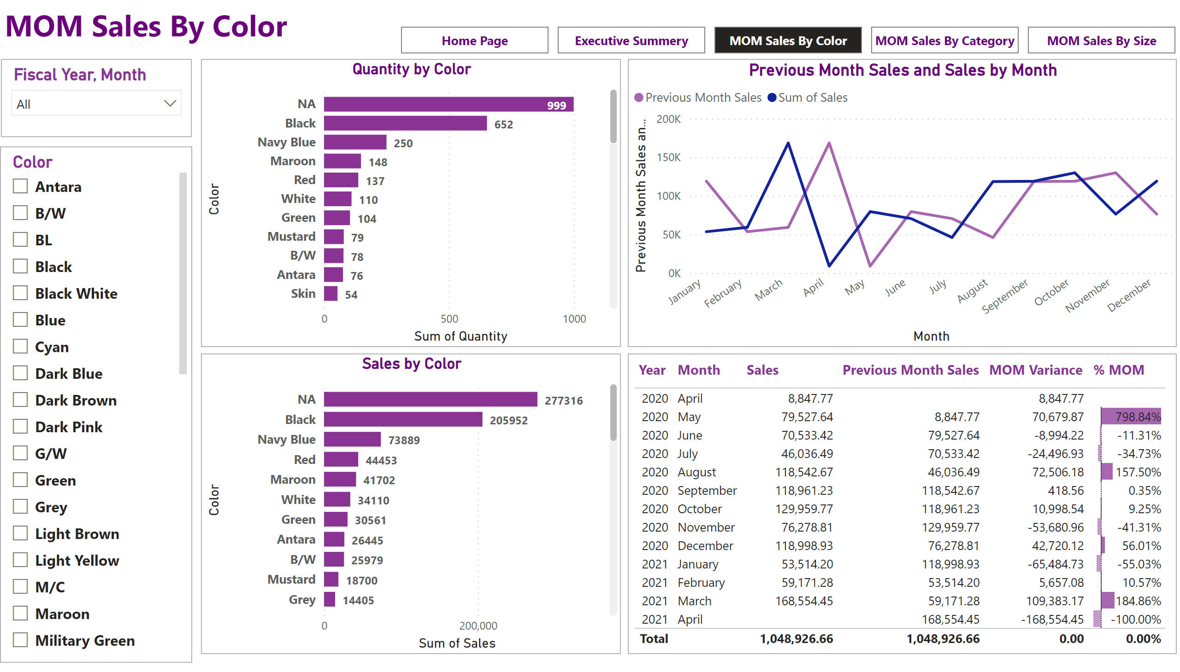
MOM Sales By Color
Notes:
slicer
No alt text provided
Sales by Color
No alt text provided
slicer
No alt text provided
tableEx
No alt text provided
Previous Month Sales and Sales by Month
No alt text provided
Quantity by Color
No alt text provided
textbox
No alt text provided
pageNavigator
No alt text provided

Slide 4
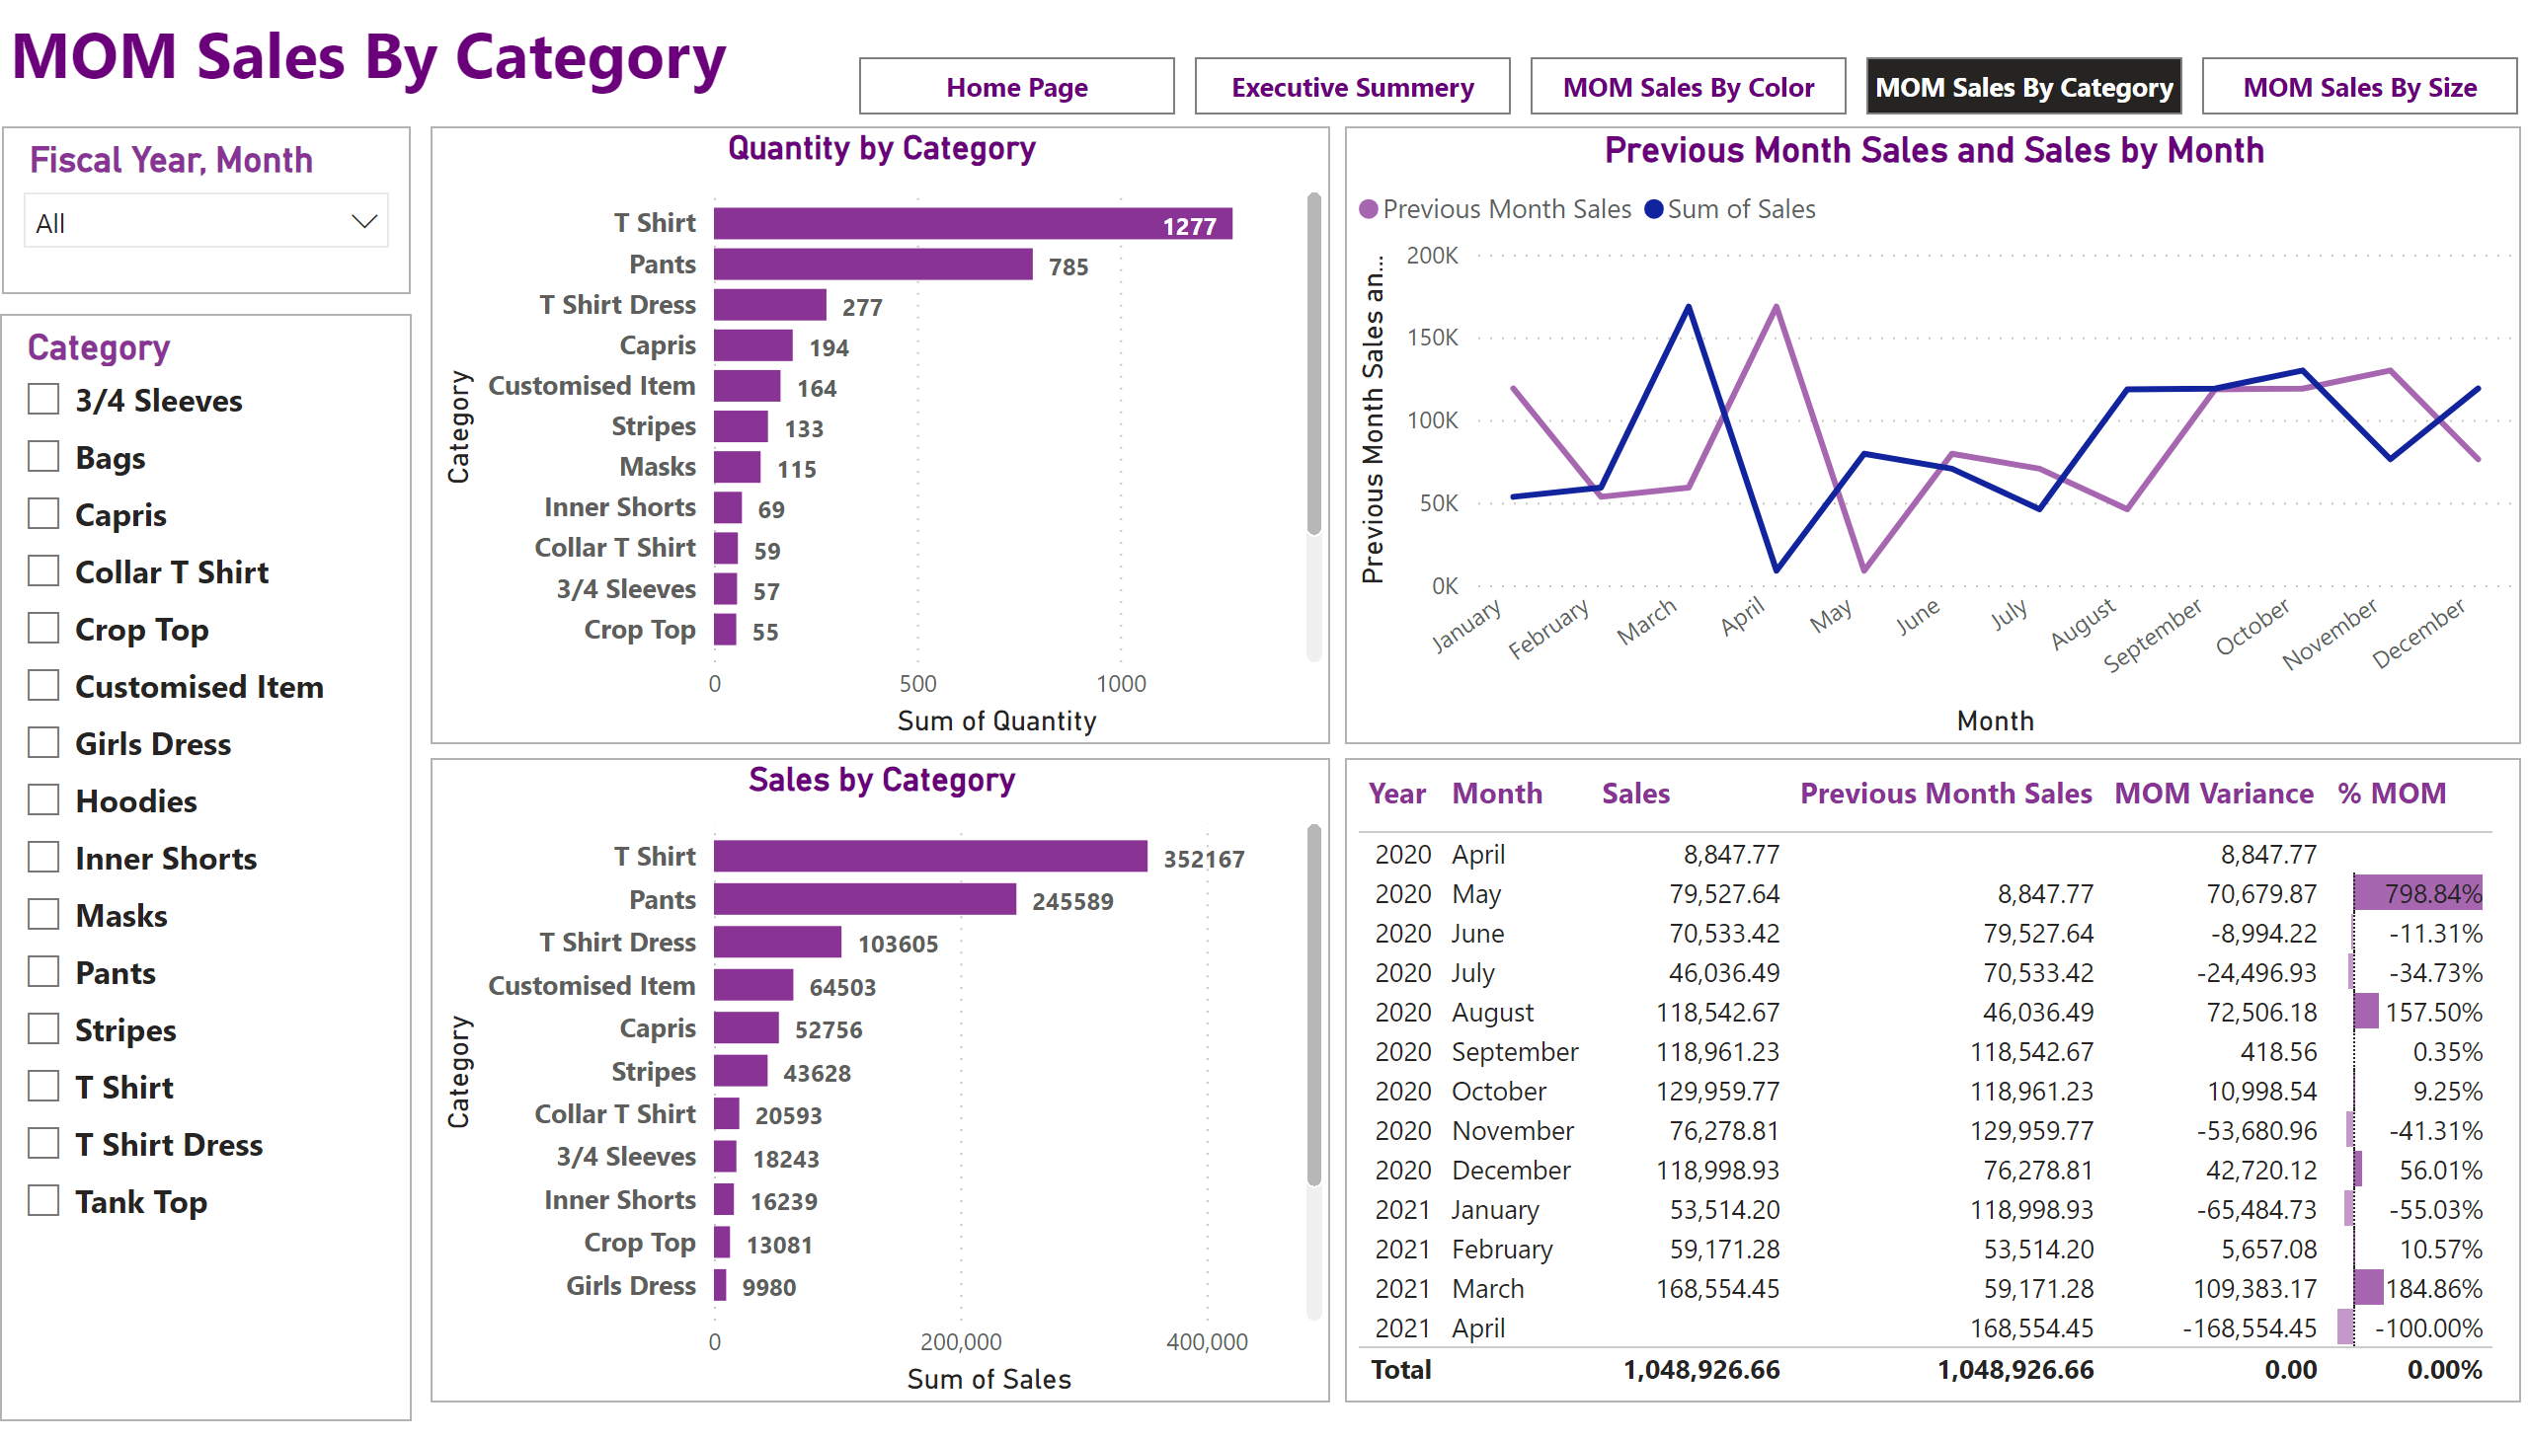
MOM Sales By Category
Notes:
slicer
No alt text provided
Sales by Category
No alt text provided
slicer
No alt text provided
tableEx
No alt text provided
Previous Month Sales and Sales by Month
No alt text provided
Quantity by Category
No alt text provided
textbox
No alt text provided
pageNavigator
No alt text provided

Slide 5
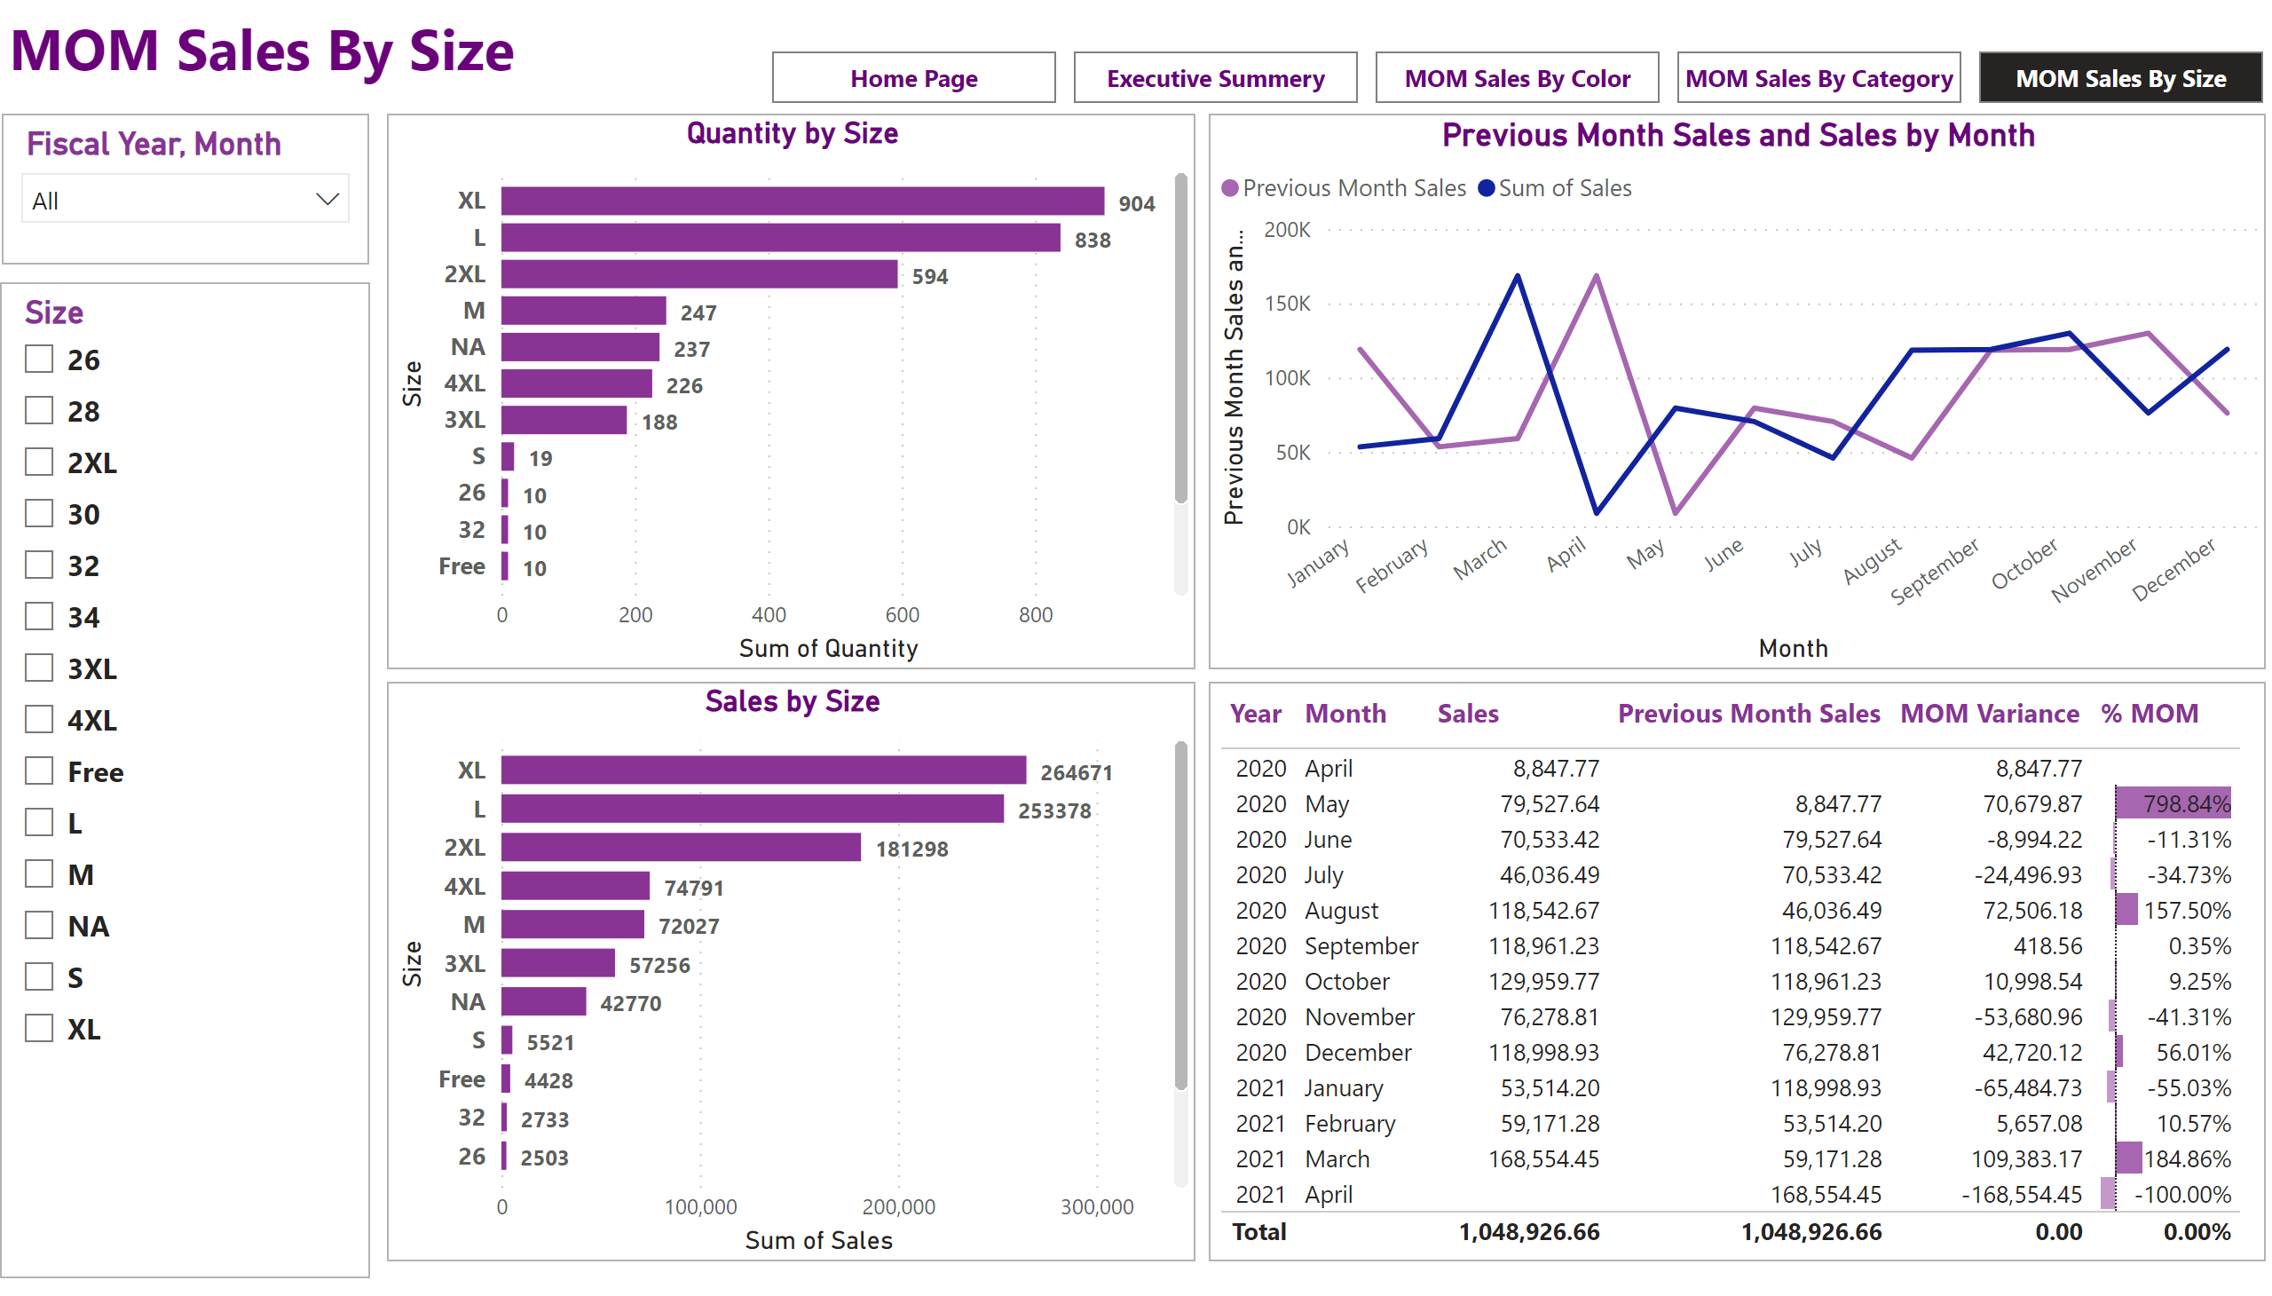
MOM Sales By Size
Notes:
slicer
No alt text provided
Sales by Size
No alt text provided
slicer
No alt text provided
tableEx
No alt text provided
Previous Month Sales and Sales by Month
No alt text provided
Quantity by Size
No alt text provided
textbox
No alt text provided
pageNavigator
No alt text provided

